Slide 1
Student Score Prediction
Implementation of Linear Regression
Using Python & Scikit-Learn

Slide 2
What is Linear Regression?
Linear Regression is a statistical method that models the relationship between a dependent variable (Score) and one or more independent variables (Hours).
Goal: To find the 'Line of Best Fit' that minimizes the error between actual and predicted values.

Slide 3
The Dataset (student_scores.csv)
A snippet of the data used for training:
Hours | Scores
2.5 | 21
5.1 | 47
3.2 | 27
8.5 | 75
3.5 | 30

Slide 4
Model Training Code Snippet
from sklearn.linear_model import LinearRegression regressor = LinearRegression() regressor.fit(X_train, y_train) # Predict for a new value prediction = regressor.predict([[9.25]])

Slide 5
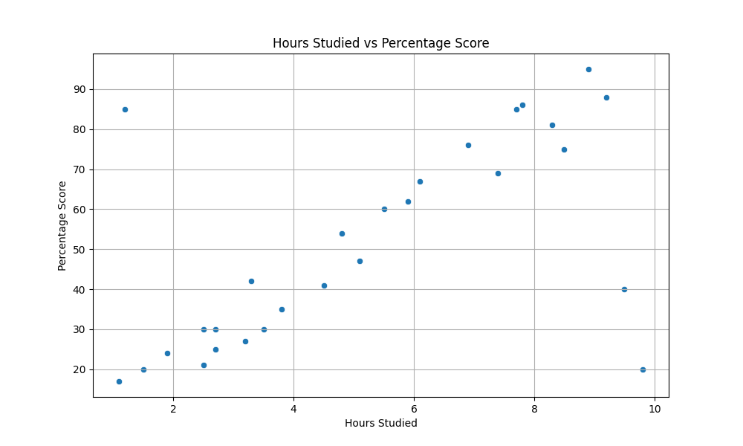
Visualizing the Correlation

Slide 6
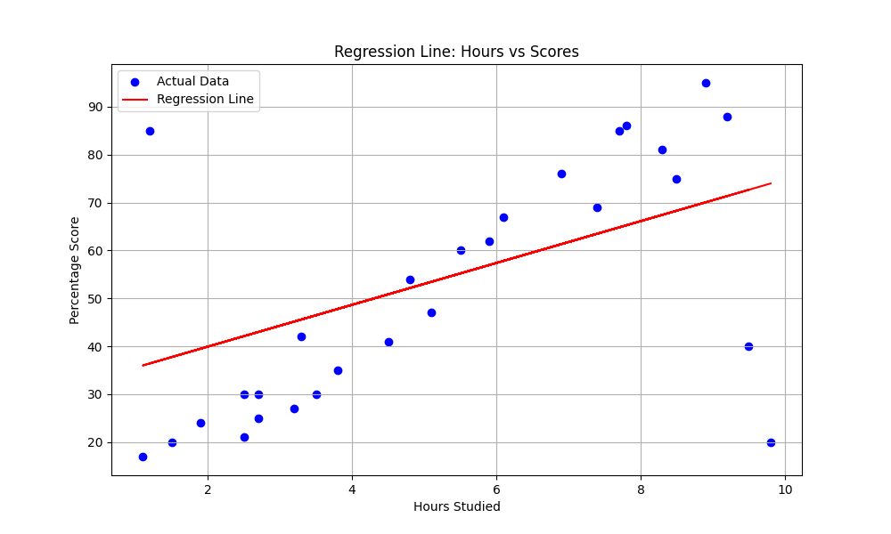
The Regression Line

Slide 7
Project Results (With Outliers)
Accuracy (R-Squared Score): -0.057 (Negative Accuracy!)
Mean Absolute Error: 14.71
Impact of Outliers:
Input: 9.25 Hours of Study/Day
Result: 71.58% Predicted Score
Lesson: Outliers can significantly skew a Linear Regression model.

